Slide 1

ASSETT
Traffic Management Modeling
GMU | DAEN 690 | Fall 2019
G. Chalamala | M. Esguerra | M. Lepe | J. Murray

Slide 2
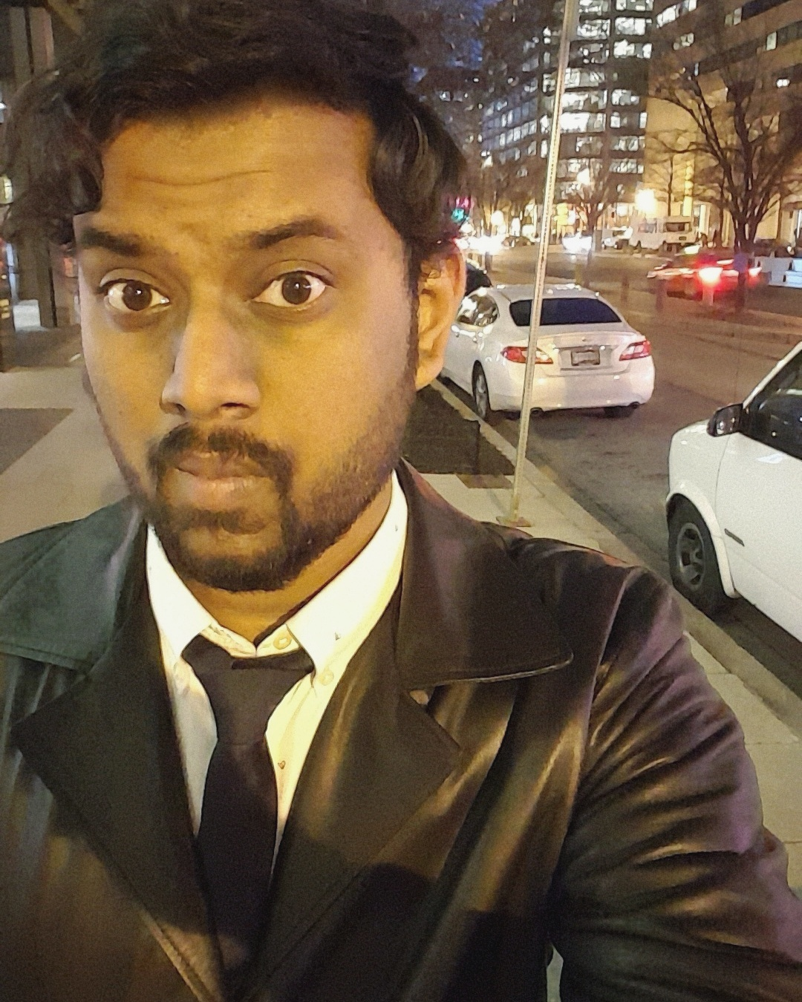
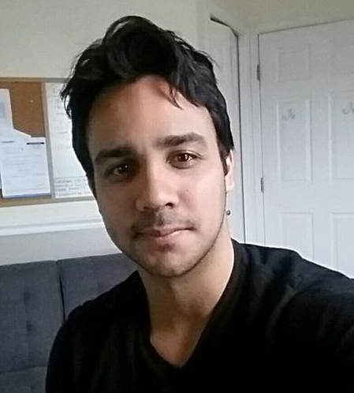

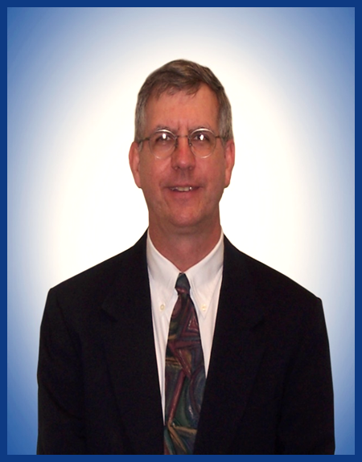

Team Members
Goutham Chalamala
Developer
Michael Lepe
Developer
Jim Murray
Product Owner
Marissa Esguerra
Scrum Master
PG. 1 | ASSETT

Slide 3
Agenda
01 Introductions
02 Problem Definition
03 Project Objectives
04 Data Sources
05 Process Followed
06 Tools/Analytics
07 Video
08 Visualization of Results
09 Risks
10 Follow-on Opportunities
11 Conclusion
Presenter: Marissa | Section: Introduction
Presenter: Marissa | Section: Problem/Objective
Presenter: Marissa | Section: Problem/Objective
Presenter: Marissa | Section: Data Source/Process
Presenter: Michael | Section: Data Source/Process
Presenter: Goutham | Section: Tools/Analytics
Presenter: Goutham | Section: Tools/Analytics
Presenter: Jim | Section: Visualization/Risk
Presenter: Jim | Section: Visualization/Risk
Presenter: Jim | Section: Conclusion
Presenter: All | Section: Conclusion
PG. 2 | ASSETT

Slide 4

Technology Application
Unlocking the Power of Location Intelligence
  Transportation in Northern VA is a major factor impacting area residents
  Average commutes are 28% longer than the
  national average
  Average person loses up to ¼ - ½ day a
  week in traffic
  The local infrastructure and road improvements
  can not keep pace with need
  Carbon Emissions and Global Warming are accelerating and changing our climate
  New technologies are on the horizon – but uncertainty with how they will be deployed
  Action is need now and alternatives are available
PG. 3 | ASSETT
Introduction
Problem/Objective
Data Source/Process
Tools/Analytics
Visualization/Risk
Conclusion

Slide 5

Problem Definition
ASSETT, Inc.
Gain an improved understanding of:
  Modeling and simulation of transportation systems
  Assess transportation analytics and current practices
  Assess transportation impacts surrounding their corporate headquarters
  Collect and advise Prince William County / Northern Virginia traffic flow optimization opportunities
PG. 4 | ASSETT
Introduction
Problem/Objective
Data Source/Process
Tools/Analytics
Visualization/Risk
Conclusion

Slide 6







What It Solves
LOW COST
Provides a rapid low-cost method of assessment of transportation improvements
INFORMATIVE
Informs Department of Transportation of benefit & impacts
IMPROVEMENTS
Allows localities to prioritize transportation impacts and improvements
ANALYSIS
Provides detailed information for further analyses
EXTENSIBILITY
Provides a modular system of elements for extensibility
ENVIORNMENTAL
Extensible to environment and local service integration, which supports: Emission Output, Traffic Optimization, Road Design, Emergency Vehicles and Traffic Flow
SOPHISTICATION
Leverages sophisticated models and pre-built components
PG. 5 | ASSETT
Introduction
Problem/Objective
Data Source/Process
Tools/Analytics
Visualization/Risk
Conclusion

Slide 7


Project Objectives
Objective Function 1:
  To maximize the flow of traffic through the defined network
Objective Function 2:
  To minimize the median transit time for the population in this network
PG. 6 | ASSETT
Introduction
Problem/Objective
Data Source/Process
Tools/Analytics
Visualization/Risk
Conclusion

Slide 8
Data Sources
HERE Traffic Commercially Collected Data
ASSETT Manually Collected Data
Virginia Department of Transportation (VDOT)
Provided by Sponsor
Provided by Sponsor
Researched
8,400 Records from July 24th, 2019 – 2pm to 4pm
Included Attributes:
  Vehicle Location, Flow, Jam Factor, Direction, Confidence, etc.
Used to Identify Bounding Criteria
How it was collected: Sensor Data, Smartphones, Connected Cars
Intersection Information
Included Attributes:
  Lane Count, Cycle, Signal Timing for each Direction
Data source used for informative purposes
How it was collected: Manual Collection from ASSETT Employees
Traffic research from VDOT
  Commute Time
  Population
  Family Population
  Vehicle Estimates
Used to Identify Bounding Criteria
How it was collected: Surveys and Sensor Data
PG. 7 | ASSETT
Introduction
Problem/Objective
Data Source/Process
Tools/Analytics
Visualization/Risk
Conclusion

Slide 9
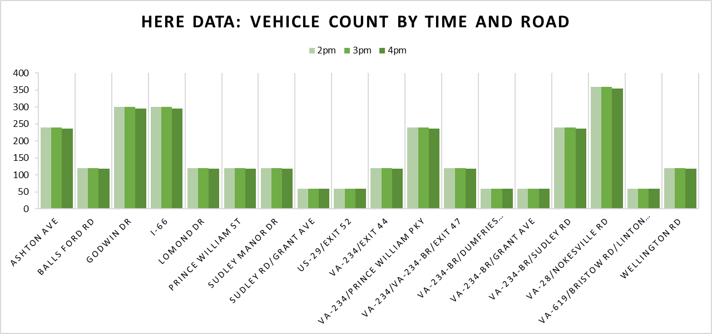
Data Exploration and Foundation
Map Provided by Sponsor
Identify Surrounding Area for:
Schools
Big Businesses
Neighborhoods
Bus Stops
HERE Data
Create Bounding Analysis:
Understand Volume & Flow
Understand Timing and Routes
Create Foundation for Synthetic Data
PG. 8 | ASSETT
Introduction
Problem/Objective
Data Source/Process
Tools/Analytics
Visualization/Risk
Conclusion

Slide 10
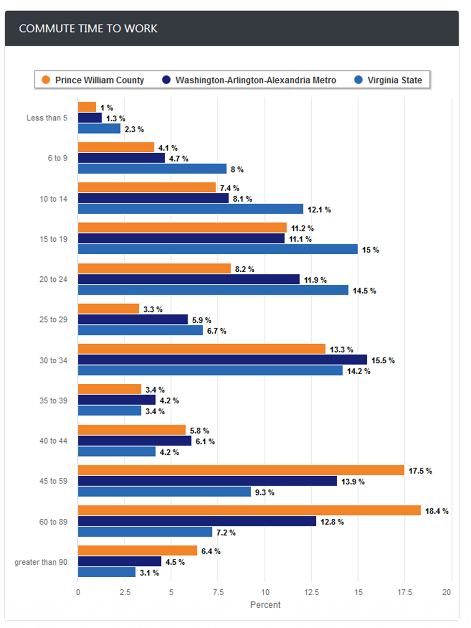
Data Exploration and Foundation
VDOT Exploratory Research
Identify Surrounding Area and Bounding
Prince William County Population: 468,011
Population per square mile: 202.6
Population of 5,672.8 in the area of interest
Around 3,270 vehicles in the area of interest
Average Commute time of 39 minutes
Data Source: (2016) Virginia Department of Transportation. Vehicle type by highway in 2016. http://www.virginiadot.org/info/resources/Traffic_2016/AADT_PrimaryInterstate_2016.pdf
PG. 9 | ASSETT
Introduction
Problem/Objective
Data Source/Process
Tools/Analytics
Visualization/Risk
Conclusion

Slide 11

Analytics and Modeling
Programs and Tools
  Open Street Map
    – Open Source World Map
  Simulation of Urban Mobility (SUMO)
    – Open Source Traffic Simulation Package
  NetEdit – Add-on Package for SUMO
    – Visual Network Editor
  Excel
    – Data Exploration and Visualization
PG. 10 | ASSETT
Introduction
Problem/Objective
Data Source/Process
Tools/Analytics
Visualization/Risk
Conclusion

Slide 12
Network Plan
Create a map of the area of interest
  Use bounding analysis to load synthetic data
  Analyze the outcomes for flow and optimization
  Identify the key major routes traveled daily
  Run traffic
  simulations
PG. 11 | ASSETT
Introduction
Problem/Objective
Data Source/Process
Tools/Analytics
Visualization/Risk
Conclusion

Slide 13
Solutions Considerations
Tools and Program Learning Curve and Operation
Number of Required Computer Runs
Data Integration
Timing and Loading Parameters
Due to limited data sources, created a bounding analysis and used this as a volume foundation for our synthetic data
Made use of publicly available resources, including manuals and video tutorials
Minimized our main analysis to 16 hours (5am – 8pm) and incorporated all scenarios into sixteen
1 hour files
Separated the work between team members for equal distribution
PG. 12 | ASSETT
Introduction
Problem/Objective
Data Source/Process
Tools/Analytics
Visualization/Risk
Conclusion

Slide 14
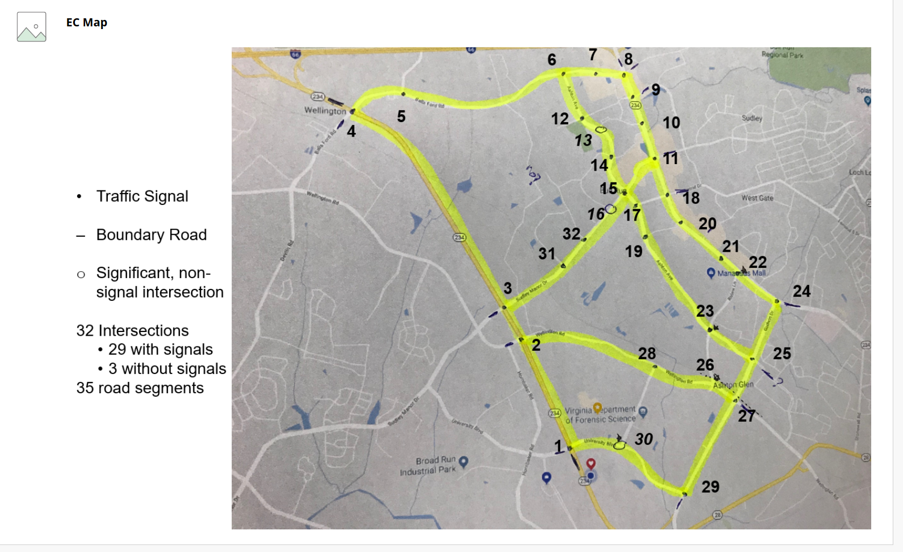
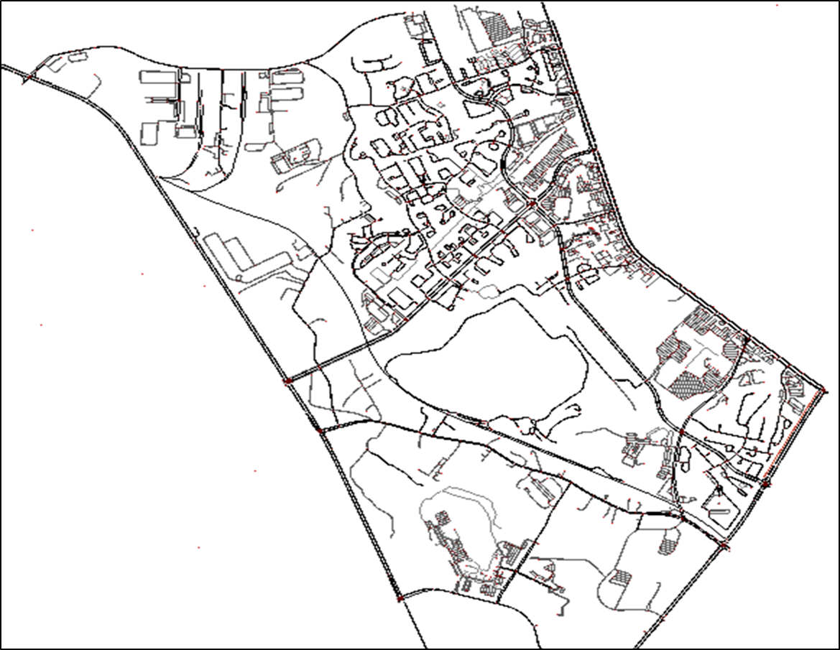
Area of Interest
Map Provided by Sponsor
NetEdit Map Loaded through Open Street Maps
PG. 13 | ASSETT
Introduction
Problem/Objective
Data Source/Process
Tools/Analytics
Visualization/Risk
Conclusion

Slide 15
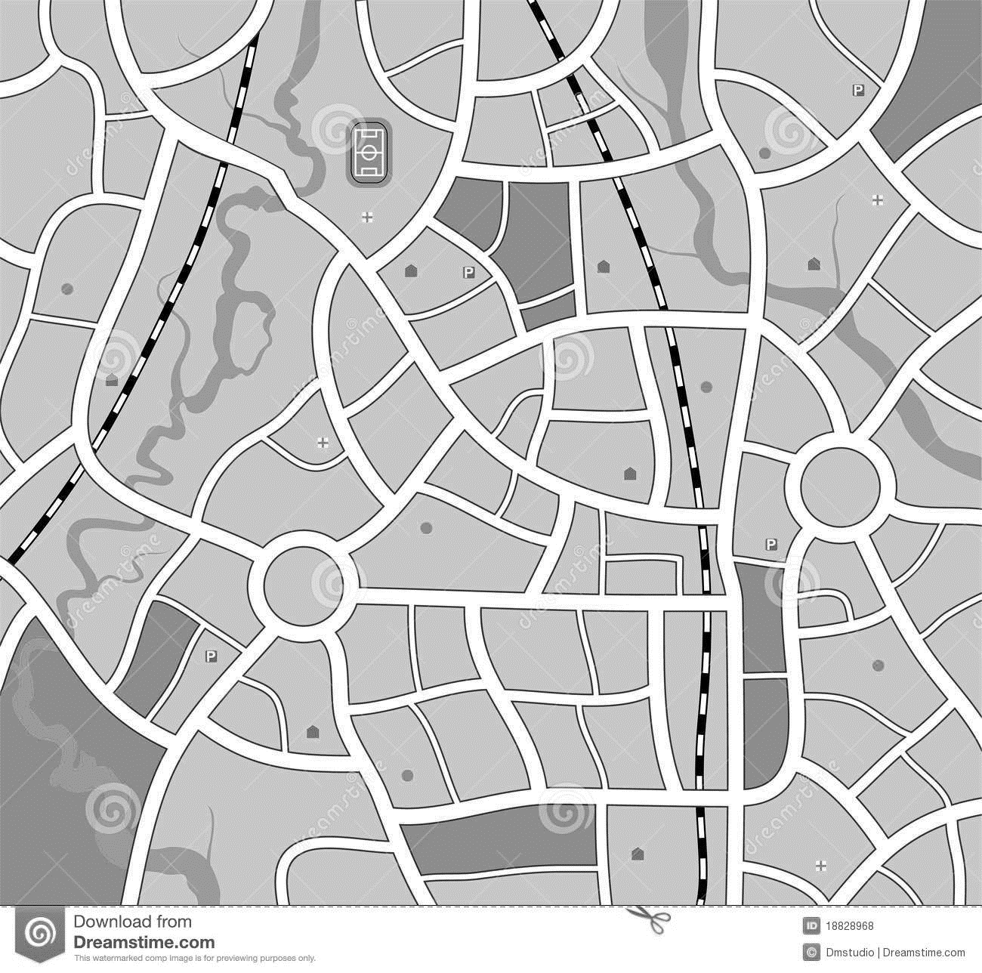
Identified Traffic Routes
1. Morning traffic commute leave suburbs to go to highways.
2. Return home commute leave highways to go to suburbs.
3. Traffic for delivery drivers during the day.
4. School bus traffic for elementary, middle, and high schools.
5. Daily shopping and activities – to stores, malls, or businesses.
6. Morning crossing traffic to get to work – presumably on the major roads.
7. Evening crossing traffic to get to work – presumably on the major roads.
8. Local business traffic that draw traffic to local companies.
PG. 14 | ASSETT
Introduction
Problem/Objective
Data Source/Process
Tools/Analytics
Visualization/Risk
Conclusion

Slide 16
Route Timing
Route Type 1 2 3 4 5 6 7 8
Time
Additional “Random Trips” incorporated throughout the day
PG. 15 | ASSETT
Introduction
Problem/Objective
Data Source/Process
Tools/Analytics
Visualization/Risk
Conclusion

Slide 17
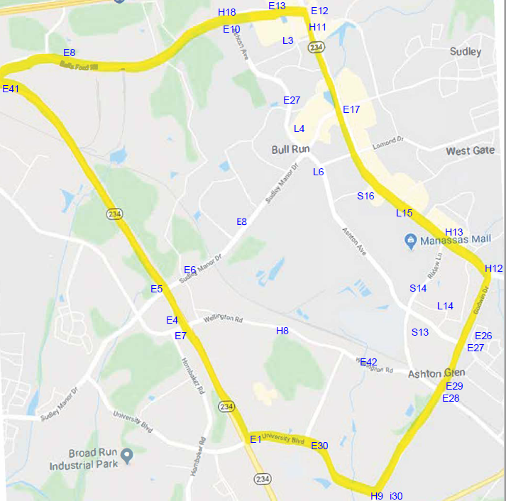
Routes & Detectors
Detectors
– Created markers within the map for key intersections and roads
– Used for:
Count of Vehicles
Output File Analysis
OD Defining
– Created an Origin & Destination
File includes:
Start Point
End Point
–Origin and destination files created for each hour analyzed
PG. 16 | ASSETT
Introduction
Problem/Objective
Data Source/Process
Tools/Analytics
Visualization/Risk
Conclusion

Slide 18

Execution of SUMO
TAZ Defining: Building a file with assigning Detectors ID to the Lane ID
ODconfig file: Consists of all vehicles and cars with paths they should take
Duarouter: Creates a SUMO CFG file which executes the simulation in command and creates routes files
Random trips.PY: Vehicles with no destination are added to the network.
Completed Simulation: SUMO CFG file is converted XML using TEST DUMP (using Command Prompt).
R Studio Parsing: Convert XML files into a executable OD CSV files.
TAZ_file.taz.xml
OD_file.od
od2trips.config.xml
od_file.odtrips.xml
network_file.net.xml
od_file.odtrips.xml
od_route_file.odtrips.
rou.xml
PG. 17 | ASSETT
Introduction
Problem/Objective
Data Source/Process
Tools/Analytics
Visualization/Risk
Conclusion

Slide 19
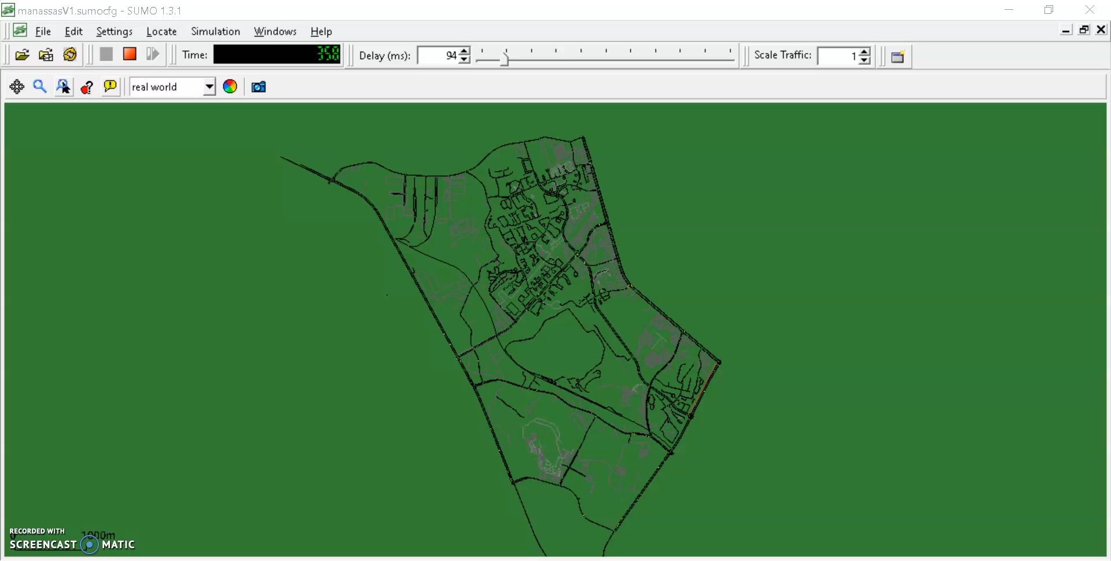
PG. 18 | ASSETT
Introduction
Problem/Objective
Data Source/Process
Tools/Analytics
Visualization/Risk
Conclusion

Slide 20
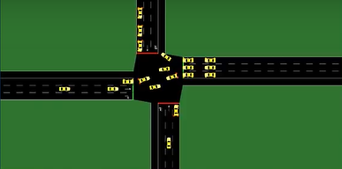
NetEdit & SUMO
SUMO Integration
– Inputs into Duarouter file
– Input data from:
  “Additional” file
    Includes OD and Detectors
– Runs the loaded simulation in SUMO
– Outputs:
  Vehicle speed (seconds)
  Detectors hit
– Allows us to identify:
  Count of vehicles on a certain road
  Flow of traffic during specific times of the day
– Execution Details
  21,000 road segments
  7+ hours processing
  Post Processing Analysis XML to CSV
PG. 19 | ASSETT
Introduction
Problem/Objective
Data Source/Process
Tools/Analytics
Visualization/Risk
Conclusion

Slide 21
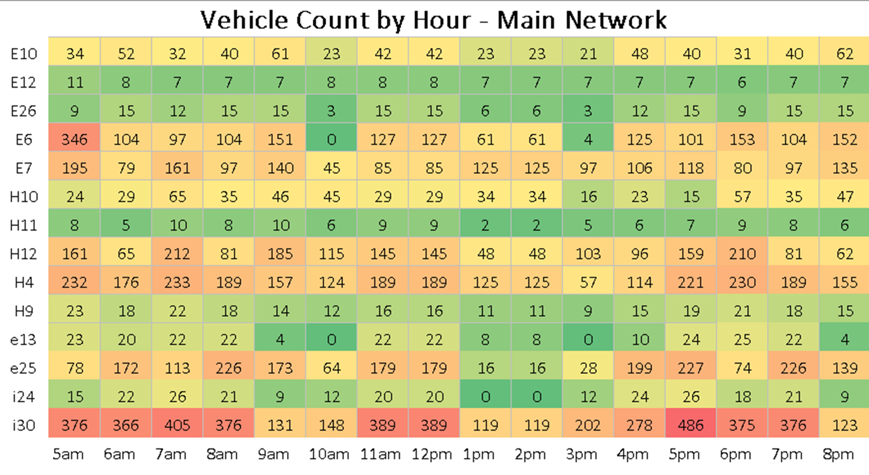
Main Enter & Exit Points
PG. 20 | ASSETT
Introduction
Problem/Objective
Data Source/Process
Tools/Analytics
Visualization/Risk
Conclusion

Slide 22
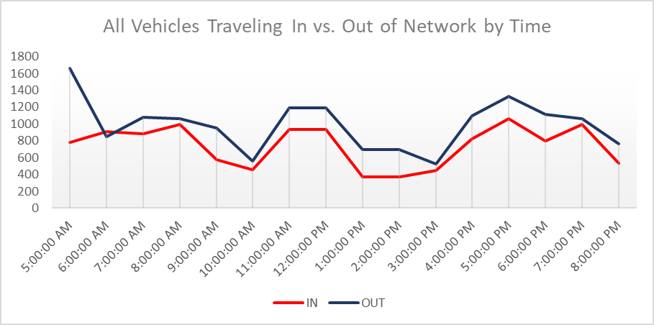
Aggregated Summary
PG. 21 | ASSETT
Introduction
Problem/Objective
Data Source/Process
Tools/Analytics
Visualization/Risk
Conclusion

Slide 23

Data Validation & Confidence
Outcome Analysis
Data volumes correlated to observed data from ASSETT Survey
Data routes correspond to VDOT/ Prince William Country data
Basic Agreement with HERE data
Random trips included as stochastic load – with a normal distribution
Simulation derived data roughly corresponds to overall traffic volume
Mean commute time for duration is representative of Norther Virginia Area
Basic alignment but limited due to lack of definitive route information for traffic
Customer understands and accepts model data results
PG. 22 | ASSETT
Introduction
Problem/Objective
Data Source/Process
Tools/Analytics
Visualization/Risk
Conclusion

Slide 24


Summary
Collection and organization of data sources for development and integration for simulation
Proven technology application with SUMO Integration
Low cost, rapid development system of tools for transportation domain
Adaptation, configuration, and tuning of data for local use
Provide a realistic model foundation with extensible elements to further detailed analysis
Enables rapid computer-based trade-off of alternatives
PG. 23 | ASSETT
Introduction
Problem/Objective
Data Source/Process
Tools/Analytics
Visualization/Risk
Conclusion

Slide 25

Further Research
Current Simulation
Enabled a significant understanding of the problem spaces tools and techniques available
Enabled the collection of data sources and data repositories available as well as a technology assessment
Served to clarify visualizations and representation of the transportation model and simulation results for ASSET, Inc. and other sponsors
Enhance Simulation
FLOW Reinforcement Learning
Neural Networks
Reinforcement Learning – Advanced Extensions
PG. 24 | ASSETT
Introduction
Problem/Objective
Data Source/Process
Tools/Analytics
Visualization/Risk
Conclusion

Slide 26

Acknowledgements
We would like to acknowledged the leadership of our sponsor, ASSETT Inc:
  Mr. James Villani
  Mr. Nick Bruno
  Mr. James St John
We would also acknowledge:
  Dr. Vadim Sokolov – for his support and guidance in Deep Reinforcement Learning
  Azadeh Yazdi – Graduate student who works with Dr. Sokolov
PG. 25 | ASSETT
Introduction
Problem/Objective
Data Source/Process
Tools/Analytics
Visualization/Risk
Conclusion

Slide 27
ASSETT
Traffic Management Modeling
GMU | DAEN 690 | Fall 2019
G. Chalamala | M. Esguerra | M. Lepe | J. Murray

Slide 28
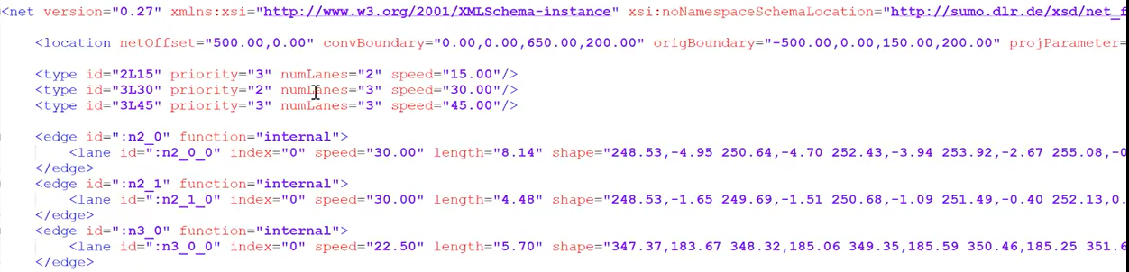
Process Diagram(1)
Input and Configuration Files
1 | Node file creation (.nod.xml)
2 | Edge file creation (.edg.xml)
3 | Edge type file creation (.type.xml)
4 | Network Creation from above files
my_nodes.nod.xml
my_edge.edg.xml
my_type.type.xml
my_net.net.xml
5 | Route file (.rou.xml)
PG. 12 | ASSETT
Introduction
Problem/Objective
Data Source/Process
Tools/Analytics
Visualization/Risk
Conclusion

Slide 29

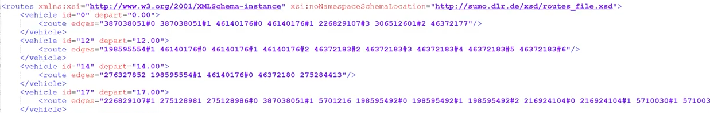
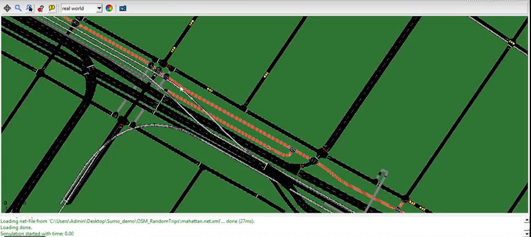
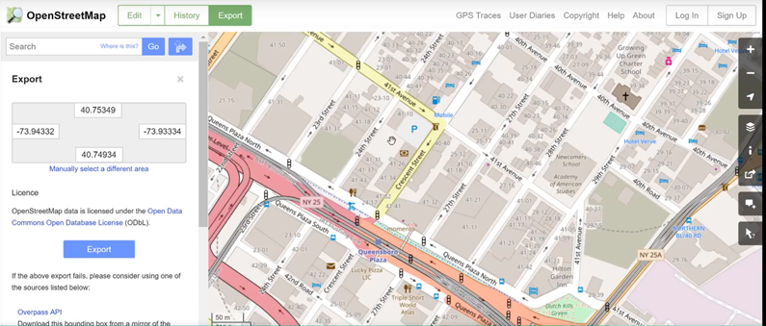
Process Diagram(2)
Input and Configuration Files
Open Street Map Extract & Filter
1 | Search and Download Open Street Map (OSM)
2 | Convert the Map into SUMO Network
netconvert ---osm-files map.osn –o test.net.xml
3 | Add trip and route to the network using build
in Phyton Scripts
randomTrips.py
python PATH\randomTrips.py –n test.net.xml – r test.rou.xml –e 50 –I
py PATH\randomTrips.py –n test.net.xml – r test.rou.xml – e 50 -I
Translate to XML Data and Routes
Open Street Map Commercial Data
PG. 13 | ASSETT
Introduction
Problem/Objective
Data Source/Process
Tools/Analytics
Visualization/Risk
Conclusion

